Slide 1

Agentic AI-Driven Multi-Agent Framework for Financial Data Analysis
Department of Artificial Intelligence & Machine Learning
School of Engineering & Technology
Sanjivani University
Semester-VI, Academic Year 2025-2026
Presented By TY AIML SEM II
Sanket Parjane 2124UMLM2044
Soham Wadale 2124UMLM2081
Gayatri Jagtap 2124UMLF2061
Sakshi Abak 2124UMLF2019
Name of Subject: MINI PROJECT
Guided By: Dr. Devyani Jadhav

Slide 2
Introduction
The stock market has become an important avenue for wealth creation, with increasing participation from working professionals and small investors. However, most existing platforms present complex financial data, charts, and indicators that require significant time and expertise to interpret effectively.
Despite growing interest, 9–5 employees and beginners face a major challenge in making informed investment decisions due to limited time, lack of financial knowledge, and absence of simplified guidance. This often leads to confusion, poor investment choices, or complete avoidance of the market.
To address this gap, this project aims to develop an AI-driven stock analysis system that simplifies complex market data and provides quick, clear, and actionable investment insights with minimal user effort.
The scope of this project focuses on building a user-friendly interface that delivers one-click stock analysis and recommendations, specifically designed for beginners and time-constrained users. It prioritizes simplicity, speed, and usability, without going deep into advanced trading strategies or high-frequency trading systems.

Slide 3
Problem Statement
.
Working professionals with full-time 9–5 jobs often struggle to actively participate in the stock market due to limited time and lack of financial expertise. Existing platforms primarily provide complex and raw financial data, which is difficult for beginners and small investors to interpret effectively. As a result, users are unable to make informed investment decisions, leading to missed opportunities, poor investments, or complete avoidance of the stock market. There is a need for a simplified, intelligent system that can analyze stock data and provide clear, actionable insights in minimal time.
Impact:
Working professionals cannot actively track and analyze multiple stocks
Beginners depend on random tips or social media, leading to losses
Lack of a simple, intelligent platform creates confusion
Results in missed opportunities and poor financial growth

Slide 4
Literature Survey
The growth of FinTech has led to the development of stock analysis platforms like Yahoo Finance and Bloomberg, which provide extensive financial data but require users to interpret complex information, making them less suitable for beginners and time-constrained professionals.
Research in this domain has explored machine learning models such as Linear Regression, SVM, and LSTM for stock prediction. While these models can forecast price trends, they are often complex, resource-intensive, and lack interpretability for general users.
With recent advancements, AI and Large Language Models (LLMs) have enabled systems to generate human-like insights from financial data. Additionally, multi-agent systems have been introduced, where specialized agents handle tasks like risk, value, and trend analysis collaboratively.
However, most existing solutions either focus on raw data or complex predictions, lacking a balance between simplicity, automation, and interpretability. This project addresses this gap by combining real-time data analysis with a multi-agent AI framework to provide quick, clear, and user-friendly investment insights.

Slide 5
Proposed Methodology
The proposed system is an AI-driven stock analysis platform that utilizes a multi-agent framework to simplify financial decision-making for working professionals and beginners.
The system follows a structured workflow. First, the user provides stock ticker symbols and selects a timeframe through a Streamlit-based interface.
The system then collects real-time and historical market data using the Yahoo Finance API. This data is processed to calculate key financial metrics such as returns, volatility, Sharpe ratio, maximum drawdown, and P/E ratio.
Next, the processed data is analyzed using a multi-agent AI system consisting of three specialized agents: Value Analyst, Risk Analyst, and Momentum Analyst. Each agent evaluates the stocks from its respective perspective and generates concise insights. These insights are then combined by a central AI agent (CIO), which produces a final consolidated investment decision.
The system also includes interactive data visualization using Plotly to help users understand stock trends and performance. Additionally, a comprehensive PDF report is generated containing performance metrics, charts, and AI-based analysis for easy access and sharing.

Slide 6
Key Features
Core Features of the System
1)One-click stock analysis for multiple stocks
2)Real-time data fetching using Yahoo Finance API
3)Calculation of key financial metrics:
4)Return (%)
5)Volatility (%)
6)Sharpe Ratio
7)Max Drawdown
8)P/E Ratio
AI-powered multi-agent analysis:
1)Value analysis
2)Risk analysis
3)Momentum analysis
4)Final investment decision by AI (CIO agent)
5)Interactive stock price charts with moving average
6)Automated PDF report generation
7)Simple and user-friendly interface for beginners

Slide 7
Objectives
Users can analyze multiple stocks instantly with one click.
Simplified understanding of complex financial data.
AI-generated insights for better decision making.
Time-saving solution for working professionals (9–5 users).
Reduced dependency on expert knowledge or external advice.
Clear comparison between different stocks.
Downloadable PDF report for detailed analysis.

Slide 8
Domain and Technology Stack
Domain:
1)Artificial Intelligence (AI)
2)Financial Technology (FinTech)
3)Data Analysis & Visualization
Technology Stack:
1)Frontend / Interface – Streamlit (for web app UI)
2)Backend – Python (for application logic and processing)
3)Deployment – Streamlit Cloud (for hosting and running the application)
4)Data Source – Yahoo Finance API (yFinance for real-time stock data)
5)AI Framework – LangChain (for multi-agent system)
6)AI Model – Groq LLM (LLaMA 3 for analysis and decision making)
7)Data Processing – Pandas & NumPy (for calculations and data handling)
8)Visualization – Plotly (interactive charts)
9)Visualization – Matplotlib (for PDF chart generation)
10)Report Generation – ReportLab (for generating PDF reports)

Slide 9
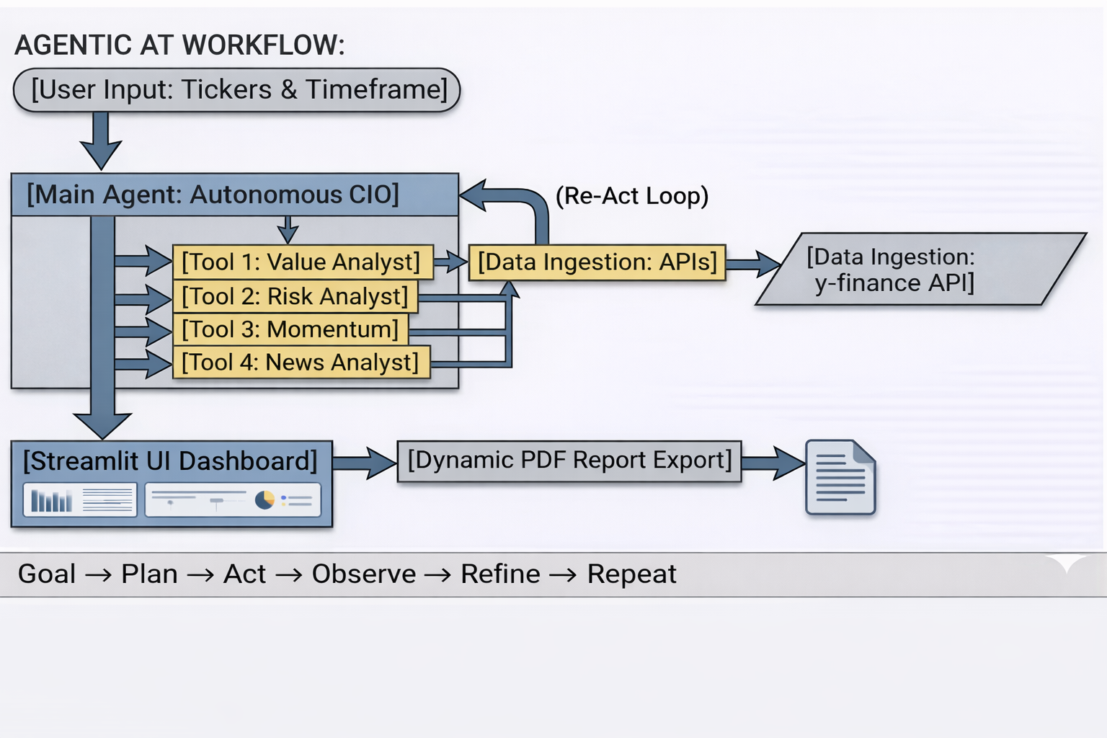
System Architecture

Slide 10
Implementation
Specialized AI Agents
1) Chief Investment Officer (CIO)
Combines all agent outputs
Gives final investment decision and summary
2) Value Analyst
Focuses on stock valuation
Uses P/E ratio to check if stock is overvalued or undervalued
P/E= Current Stock Price /Earnings Per Share (EPS) ​

Slide 11
Implementation
3) Risk Analyst
Evaluates risk using:
i)Volatility: Standard deviation of returns → measures how much price fluctuates
Multiply by √252 → converts daily volatility to annual volatility (252 trading days)
Multiply by 100 → convert to percentage Volatility=σ daily​×252​×100 ii)Max Drawdown:
Convert returns into cumulative growth (like portfolio value over time)
Track highest value reached so far
Measure how much it falls from that peak Drawdown= Peak Value​ - Current Value
iii)Sharpe ratio: (Efficiency Score) Sharpe Ratio=Average Return/Volatility​×√252
iv)Helps understand how risky the investment is.

Slide 12
Implementation
4) Momentum Analyst
Focuses on price action and trend direction
Uses percentage growth and moving averages to determine if an asset has strong upward or downward momentum
i) Total Return:
Measures the overall percentage change in the asset's price over the selected timeframe.
Return (%) = (Current Price − Initial Price) / Initial Price × 100
ii) Moving Average (e.g., 50-Day SMA):
Smooths out daily price fluctuations to identify the core trend.
SMA = Sum of Closing Prices over N days/ N days
5) News Sentiment Analyst
Focuses on short-term market catalysts and qualitative data.
Evaluates recent news headlines to determine if there is an immediate "Boom" (positive catalyst) or a negative/neutral market outlook.
i) Natural Language Processing (NLP):
Unlike the other agents, this agent relies on text analysis rather than pure math.
ii) Execution Condition:
Only activated during short-term (e.g., 6-Month) investment strategies where daily news heavily influences price action. It is intentionally ignored for long-term (3-Year) strategies to filter out market noise.

Slide 13
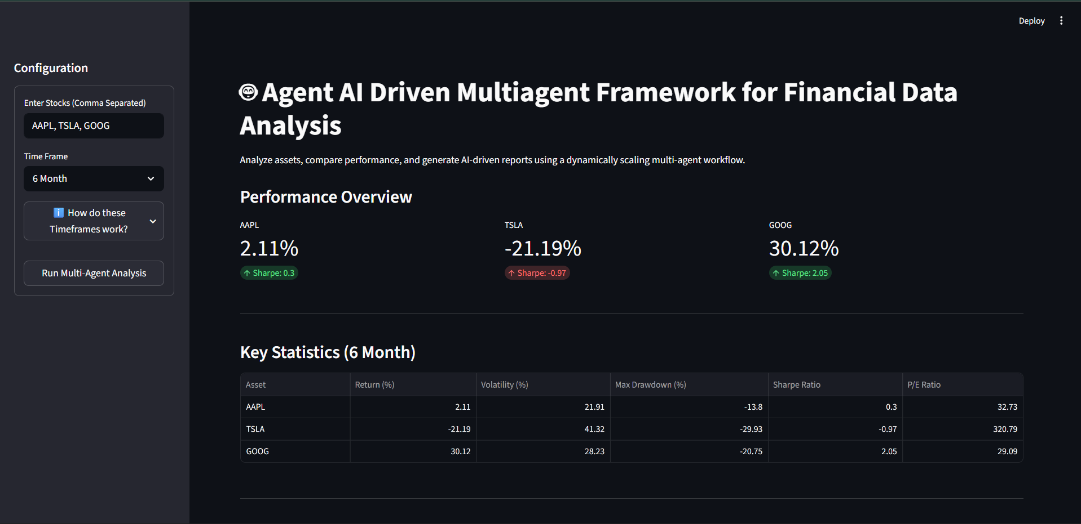
Result
fig 1: Stock Performance & Statistics

Slide 14
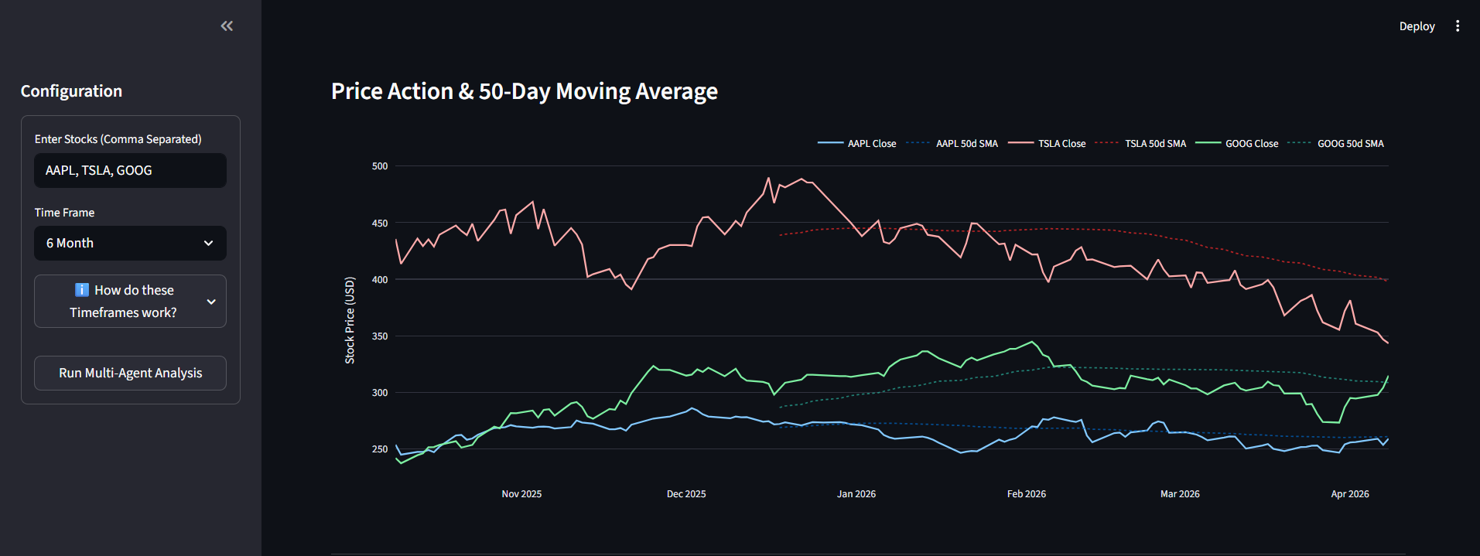
Result
fig 2: Stock Price Momentum Line Chart

Slide 15
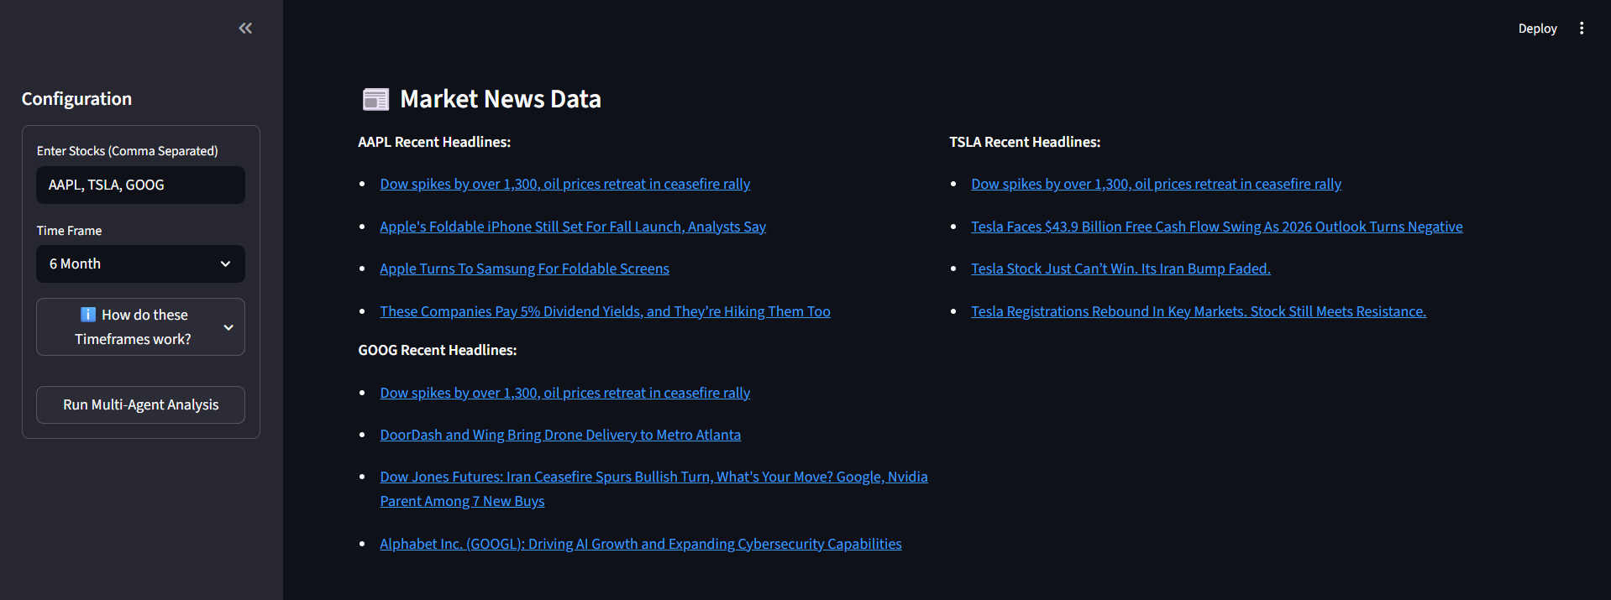
Result
fig 3: News Data

Slide 16
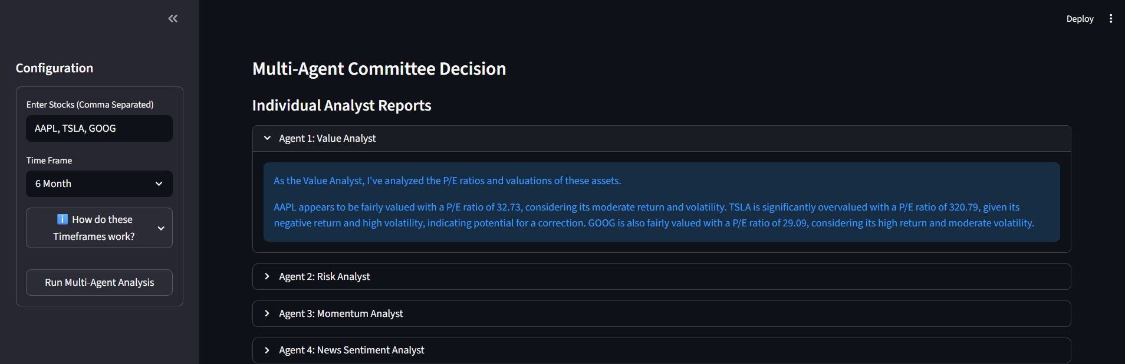
Result
fig 4: Individual Analyst Reports

Slide 17
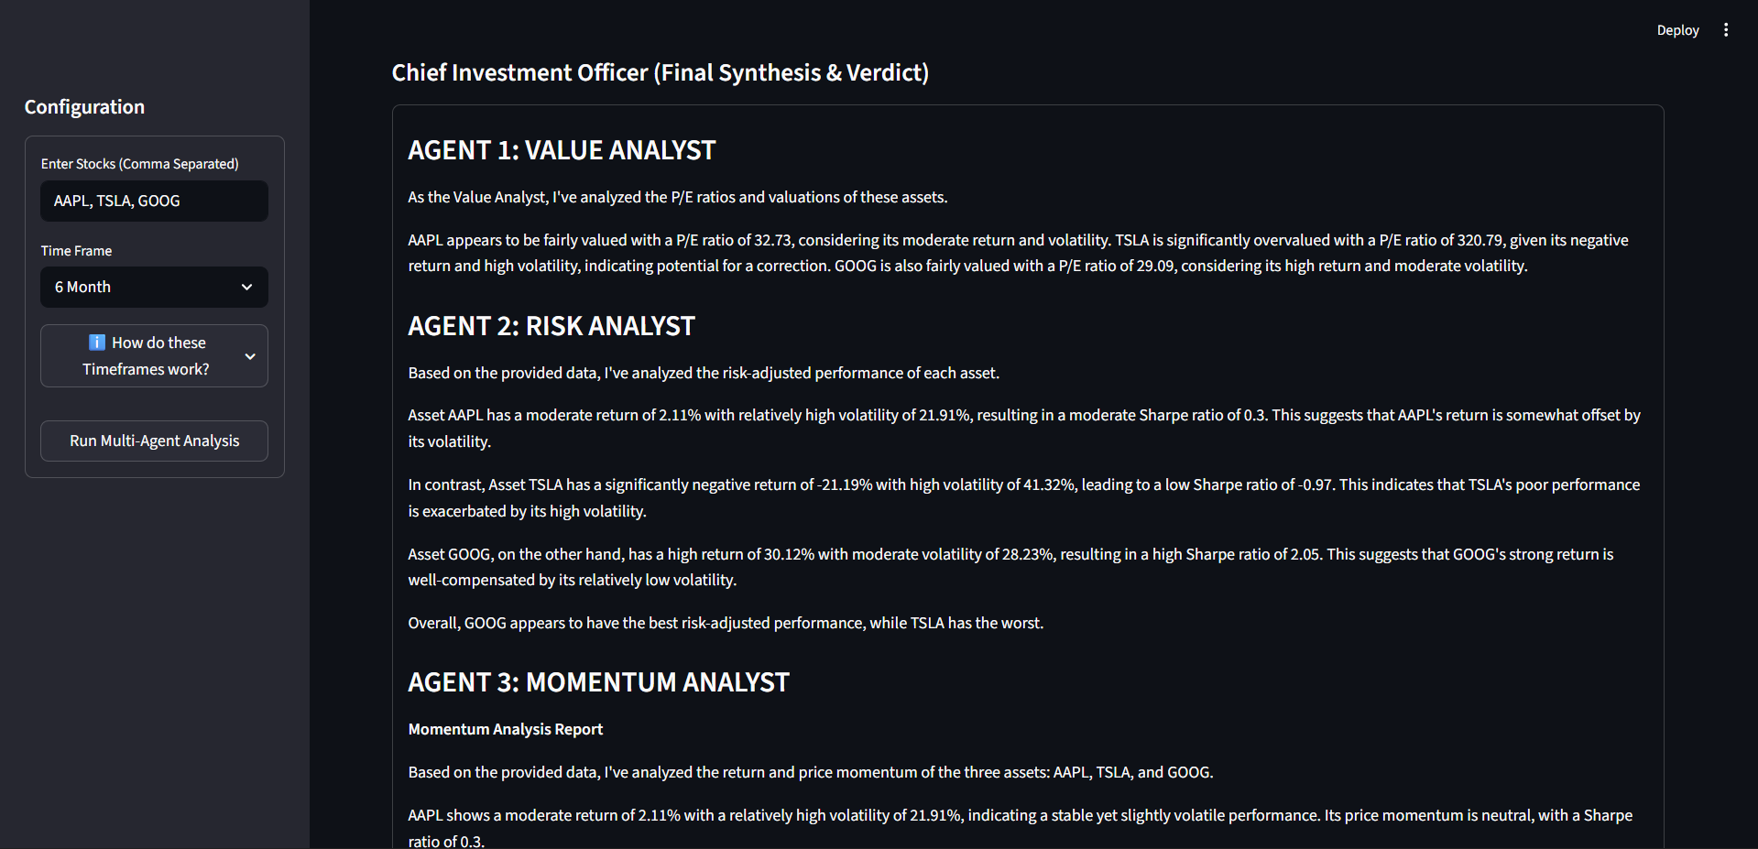
Result
fig 5: CIO Final Verdict

Slide 18
Comparison
Limitations in Existing Systems (For Investors) | How Proposed System Improves Investment Decisions
Focus mainly on prediction, not clear decision guidance | Provides clear final investment decision (best stock selection)
Outputs are confusing (charts, indicators, signals) | Gives simple, easy-to-understand insights
No clear explanation why a stock is good or bad | Explains using Value, Risk, and Momentum analysis
Difficult for beginners to decide (buy/sell confusion) | Simplifies decision-making with clear recommendations
High risk due to black-box predictions | Transparent analysis reduces blind decision risk
Requires expert knowledge to interpret data | No expertise needed, beginner-friendly system
Time-consuming analysis of multiple stocks | One-click comparison of multiple stocks
No combined view of risk + return + valuation | Provides all factors together in one analysis
Hard to compare multiple stocks effectively | Direct comparison with best-performing asset identified
No summarized report for decision-making | Generates final report with complete insights

Slide 19
Result Analysis
The performance and reliability of the proposed multi-agent framework were validated through a comprehensive evaluation involving 50 independent test cases. Each test case consisted of 3–5 different stock tickers analyzed under both 6-month and 3-year timeframes, covering varied market sectors.
All financial metrics (Return, Volatility, Sharpe Ratio, Maximum Drawdown, and P/E Ratio) were cross-verified against official Yahoo Finance data and manual calculations, achieving 100% accuracy. The LangChain tool-calling mechanism successfully invoked all required specialist agents in 100% of the executions. The Chief Investment Officer (CIO) agent adhered to the strict Markdown output template in 98% of cases.

Slide 20

Result Analysis
A Human-in-the-Loop (HITL) evaluation was conducted to assess the quality and practical usefulness of the final recommendations. The Expert, Prof. Jai Rastogi, manually reviewed all 50 CIO verdicts for logical consistency with the input metrics and individual agent reports. Out of 50 cases, 47 recommendations (94%) were rated as logically sound, coherent, and actionable. The three cases with minor coherence issues occurred under highly volatile and ambiguous market conditions and were not attributed to system failures.

Slide 21
Result Analysis
Metric | Measured Value | Evaluation Method
Financial metrics calculation accuracy | 100% | Cross-verified with Yahoo Finance
CIO output format consistency | 98% | String pattern matching
Recommendation coherence (HITL evaluation) | 94% | Manual expert
Average end-to-end analysis time | 5.8 seconds | Timestamp logging
PDF report generation success rate | 100% | Automated testing
The inclusion of Human-in-the-Loop evaluation confirms that the system not only produces technically correct outputs but also delivers practically useful and trustworthy investment insights for its target users.

Slide 22
Conclusion
The AI-driven multi-agent stock analysis system effectively transforms complex financial data into simple, actionable insights. By combining advanced data analysis with intelligent decision-making, it empowers both beginners and professionals to make informed investment choices with confidence. This approach not only saves time but also reduces dependence on deep financial expertise, making stock analysis more accessible, efficient, and practical for real-world use.
Actual Outcome
Users can analyze multiple stocks instantly with one click.
Simplified understanding of complex financial data.
AI-generated insights for better decision making.
Time-saving solution for working professionals (9–5 users).
Reduced dependency on expert knowledge or external advice.
Clear comparison between different stocks.
Downloadable PDF report for detailed analysis.

Slide 23
Future Scope
Future Enhancements
Addition of more advanced AI agents (e.g., news sentiment analysis, technical indicators).
Improved AI accuracy using more financial data and models.

Slide 24
Referance:
[1] Y. Yang, X. Liu, et al., “FinGPT: Open-Source Financial Large Language Models,” arXiv preprint, arXiv:2306.06031, 2023. [Online]. Available: https://arxiv.org/abs/2306.06031
[2] X. Liu, Z. Yang, J. Chen, et al., “FinRL: Deep Reinforcement Learning for Automated Stock Trading,” arXiv preprint, arXiv:2011.09607, 2020. [Online]. Available: https://arxiv.org/abs/2011.09607
[3] Z. Jiang, D. Xu, and J. Liang, “A Multi-Agent Reinforcement Learning Framework for Portfolio Management,” arXiv preprint, arXiv:2106.08437, 2021. [Online]. Available: https://arxiv.org/abs/2311.10723
[4] H. Zhang, Y. Zhao, et al., “Large Language Models in Finance: A Survey,” arXiv preprint, arXiv:2311.10723, 2023. [Online]. Available: https://arxiv.org/abs/2311.10723

Slide 25
Thank you

